Slide 1

Prepared by group 4
QUANTUM COMPUTERS & CRYPTOGRAPHY IN POST QUANTUM ERA

Slide 2
Table of Contents
Basics of quantum computing
Quantum gates
How quantum breaks RSA
Quantum resistant cryptography (PQC)
Majorana quantum chip

Slide 3

Regular Bit
0

Slide 4
Qubits
0
0

Slide 5


Slide 6


Slide 7


Slide 8
Entanglement
When two qubits become linked, the state of one instantly affects the other — no matter how far apart they are.

Slide 9
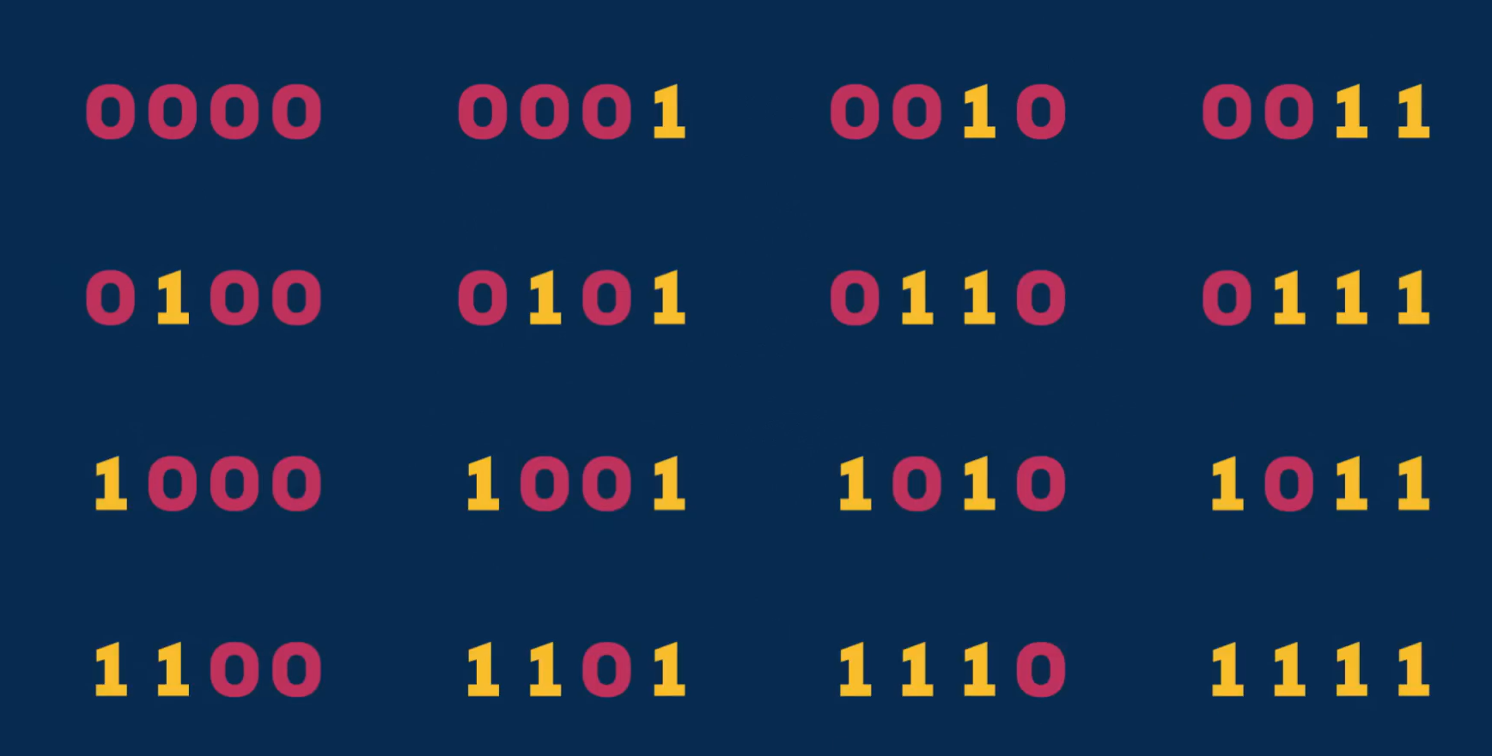

Slide 10
How quantum computers will affect current cryptographic algorithms
Current encryption working fine
Quantum computers may break encryption quick may affect the widely know public key encryption algorithms
General number field sieve takes millions of years to factor the big number generated using RSA encryption

Slide 11
Reason why quantum computers are very powerful
In a computer bit -> one state at a time
Quantum computers -> qubits need not be in one state at a time which means simulatenous superpositions.
With few qubits can represent very large powers
Difficult to represent all superpositions -> unapplicable for many uses.
Quantum fourier transform.

Slide 12
Explaining the mathematics behind prime numbers
g raised to n = mN + 1. (eventually)
Example - 77 and g = 8. We observe periodic properties of remainers modulo 77
With few qubits can represent very large powers
Euclids algorithm to find GCD. You will find prime factors of the number.
You will observe cyclicity depending on various values of n.

Slide 13
How quantum computers factor big prime numbers
Hav a superposition upto 10 to 10**1234
Make a guess g that does not share factors with n
Divide the superpositions by N and store remainders in qubits.
Obtain cyclicity by finding the period. Now use fourier transform
Find r if it is even u can put it in (g**r/2-1) *(g**r/2+1)=N. Now apply euclids algorithm to find N. This breaks the encryption. Extremely futuristic
Perfect qubits will break the encryption

Slide 14
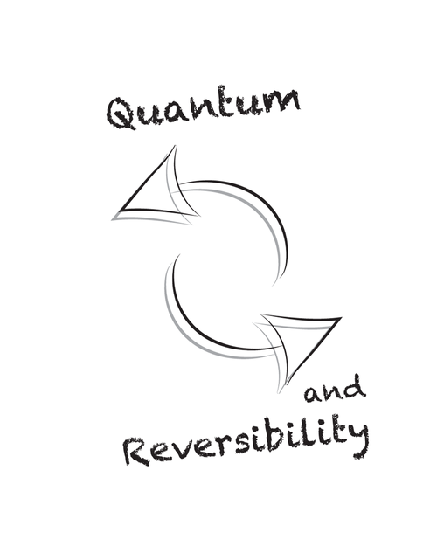
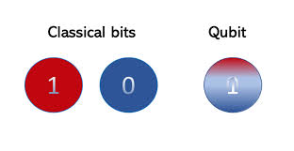
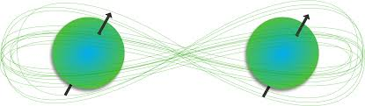
Quantum gates
Superposition
Quantum gates exploit superposition, allowing qubits to be in multiple states simultaneously, unlike classical bits.
Entanglement
They can create entangled states, linking qubits where the state of one depends on the state of another.
Reversibility
Unlike classical gates, quantum gates are reversible, meaning the operation can be undone.

Slide 15

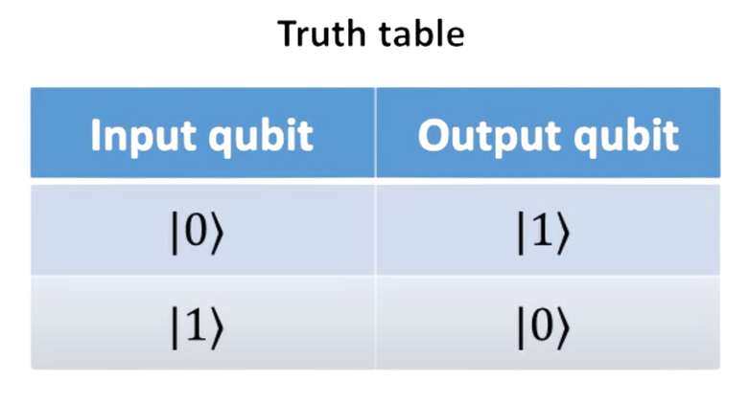
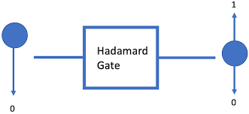
Types of Quantum Gates
Single-Qubit Gates
Pauli gate
rotate qubits around their respective axes, Example flipping |0⟩ to |1⟩
Helps To Scramble Data.
Hadamard or (H) gate
Creates superposition (|0⟩ → |1+0⟩, |1⟩ → |0−1⟩).
Use to hide data in Cryptography

Slide 16

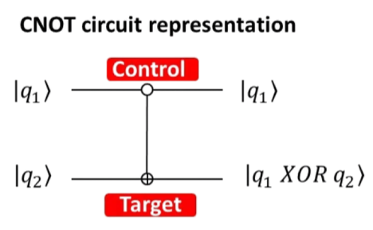
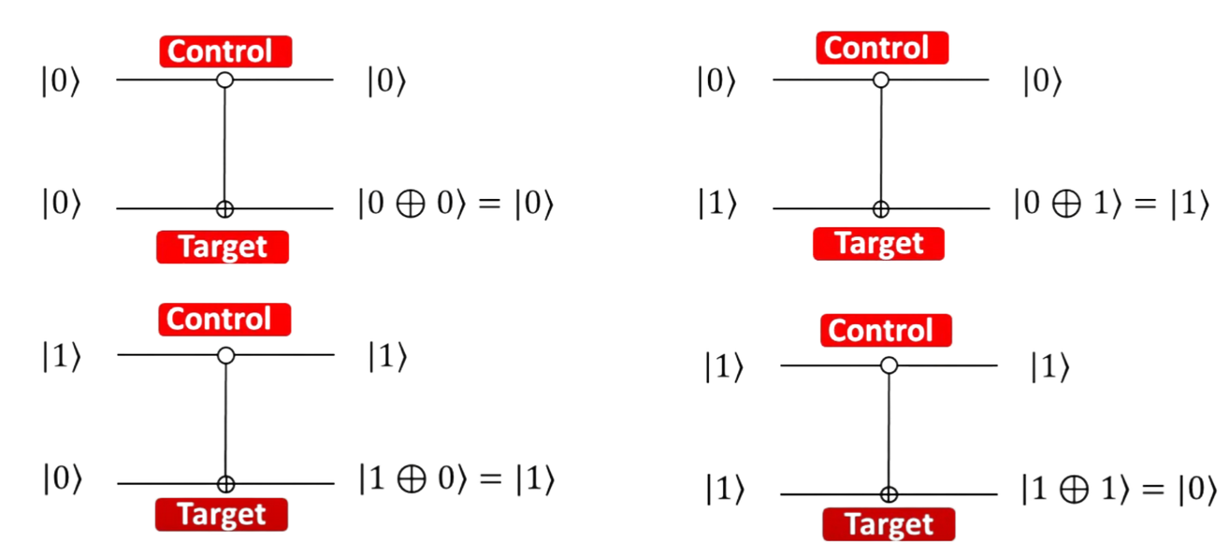
Types of Quantum Gates
Multi-Qubit Gates
Controlled Not
entangle and manipulate multiple qubits.
use to link qubits in cryptography.

Slide 17
Role of Quantum Gates In Cryptography
⚠️ Shor’s Algorithm
Uses quantum gates to factor large numbers
Can break RSA and ECC encryption
Gates like Hadamard help run the algorithm
Huge threat to current internet security
Quantum Key Distribution (QKD)
Uses gates like Hadamard and Pauli-X to send qubits securely
If someone spies, it’s instantly detected
Allows safe sharing of secret keys

Slide 18
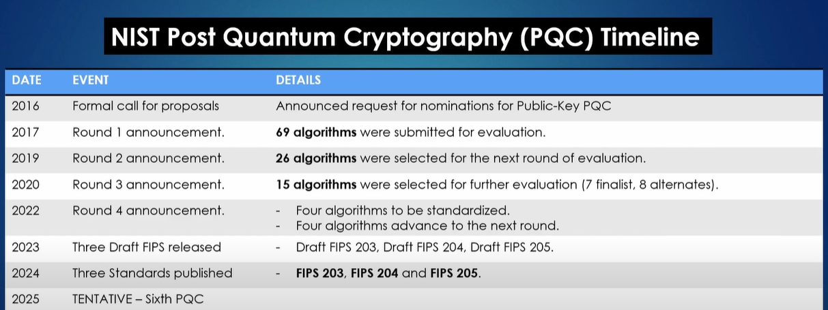
Quantum-Resistant Cryptography(PQC)
Quantum-Resistant Cryptography (Post-Quantum Cryptography - PQC)
refers to cryptographic algorithms designed to remain secure against attacks from both classical and quantum computers.

Slide 19
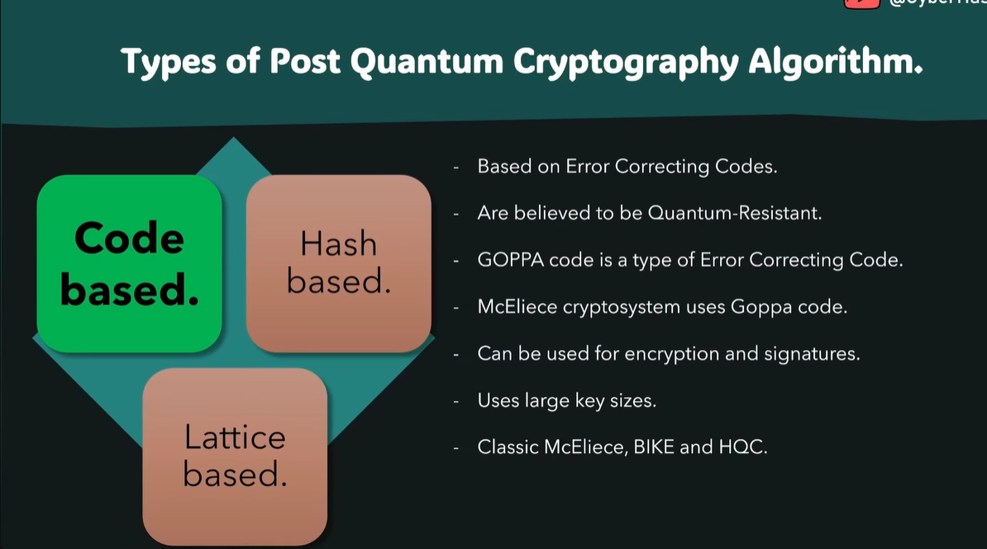

Slide 20
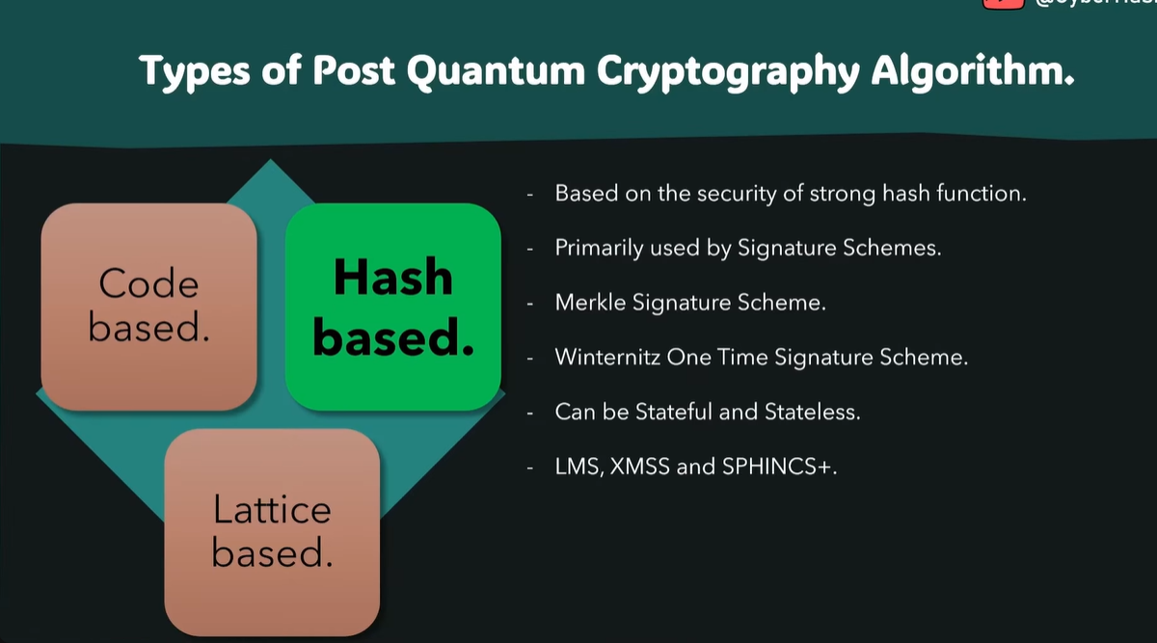

Slide 21
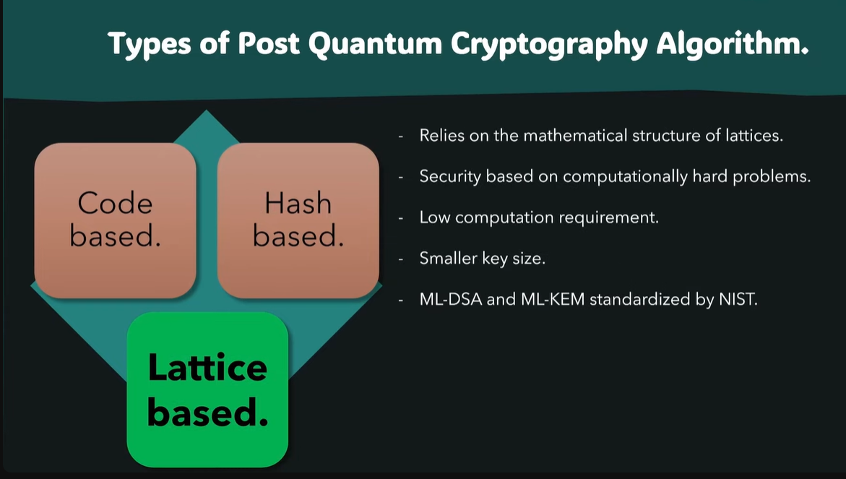

Slide 22
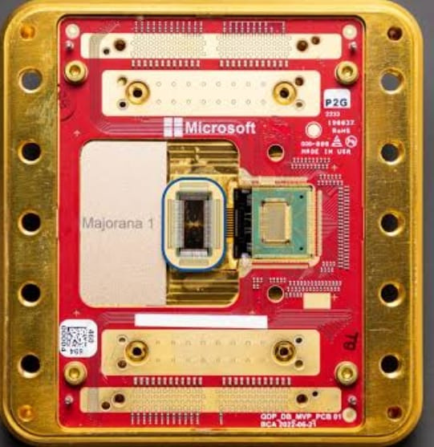
Majorana I
Introduction to Majorana particle
How can we obtain it?
How are we storing a Majorana particle?

Slide 23
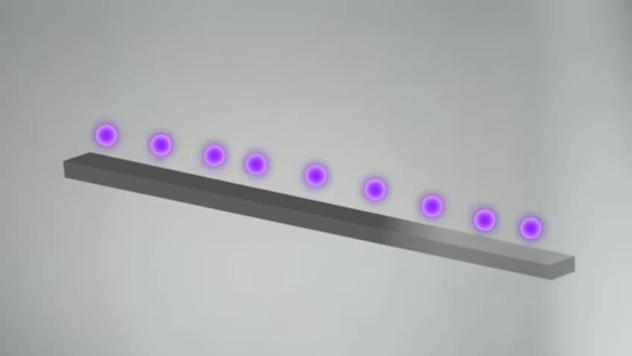

Slide 24
Future scope
Scalable Quantum Systems Are Approaching
Chips like Majorana signal the move toward fault-tolerant quantum computing.
Once this happens, quantum algorithms will run reliably, posing a real threat to classical cryptography.
Urgency of Post-Quantum Cryptography (PQC)
With reliable quantum chips coming, we must transition to PQC algorithms before quantum computers reach cryptographically relevant sizes.
Organizations like NIST are already rolling out quantum-safe standards in anticipation.
Majorana-Based Architectures in Secure Applications
The stable nature of Majorana qubits also makes them candidates for quantum-secure communications, such as quantum key distribution (QKD) and quantum networks.

Slide 25
Conclusion
Quantum computing marks a paradigm shift in computation, with the potential to revolutionize fields like cryptography, optimization, AI, and materials science.
While it poses a threat to traditional cryptographic systems, it also opens doors for quantum-resistant cryptography and new technological frontiers.
The path forward involves collaborative global efforts in research, cryptography, and hardware development to fully harness quantum potential while safeguarding digital infrastructure.
Mairona chips and similar advancements are a glimpse into a future where quantum computing becomes not just powerful but practical.

Slide 26
Thank you

